Slide 1



CONFIDENTIAL: The information in this document belongs to Boston Institute of Analytics LLC. Any unauthorized sharing of this material is prohibited and subject to legal action under breach of IP and confidentiality clauses.

Slide 2
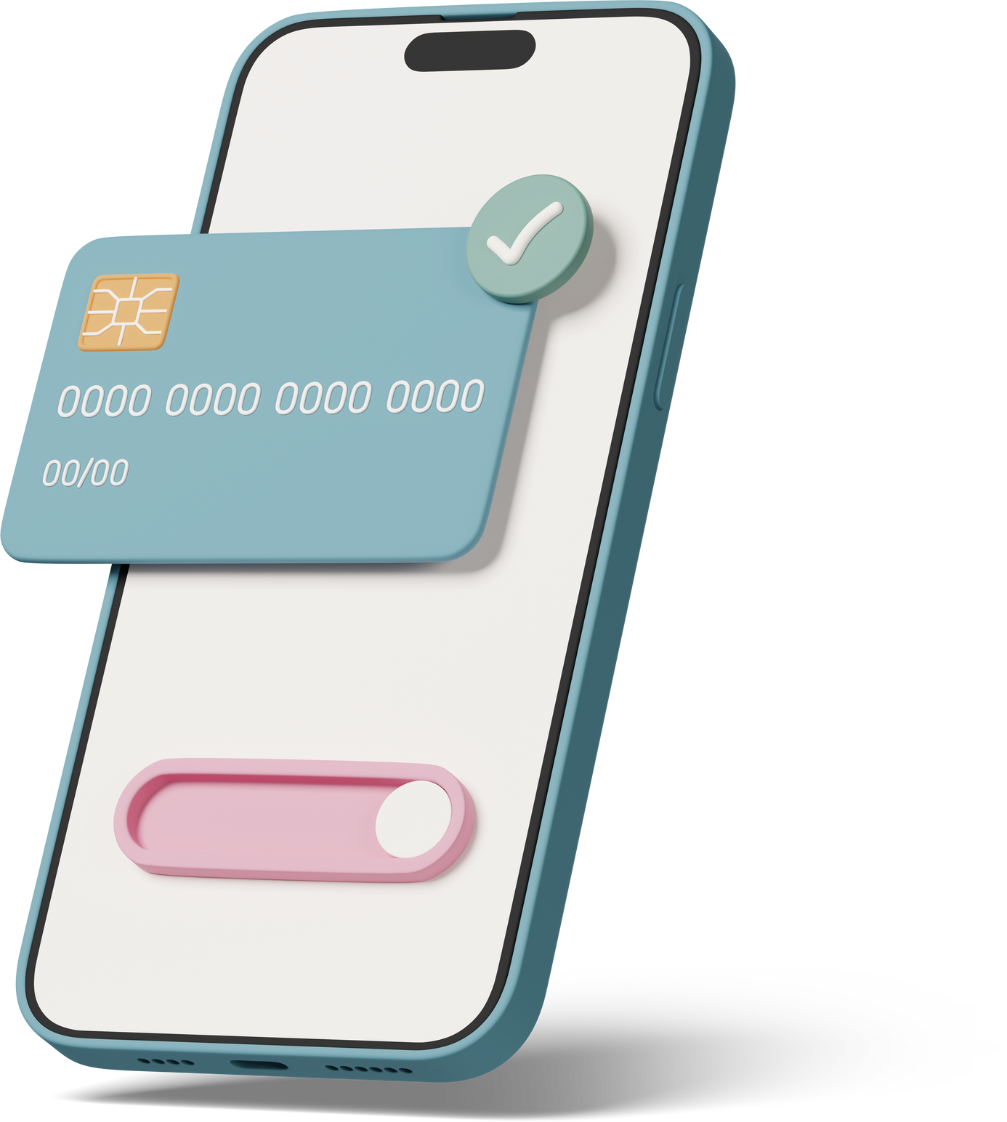

Fraud Detection in Mobile
Financial Transactions
By - Anurag Tripathi

Slide 3


Content
INTRODUCTION
RESULTS
PROBLEM STATEMENT
FINAL MODEL
WHY OUR MODEL IS USED
PERFORMANCE METRICS
OBJECTIVES
KEY INSIGHTS FROM EDA
WORKFLOW
CONCLUSION

Slide 4


Introduction
In the digital world, millions of money transactions happen every second. But not all of them are safe. Some are fraudulent, where attackers try to trick the system and steal money.
To catch such fraud, we don’t just look at who sent the money or how much was sent — we also look at how the account balances change during the transaction.
This project aims to build a machine learning model that can detect fraudulent transactions in real-time, allowing companies to:
Secure customer accounts,
Reduce financial losses,
Maintain customer trust,
Meet compliance requirements.
page 002

Slide 5


Problem Statement
Mobile financial transactions are growing rapidly due to their ease and speed. However, this digital convenience has also opened doors for advanced fraud techniques. Detecting fraud in real-time is a serious challenge for banks and fintech platforms, demanding intelligent solutions that go beyond traditional rules.
CHALLENGES IN DETECTION
GLOBAL INSIGHTS
WHY AN AI-BASED APPROACH?
Over billions of mobile transactions occur worldwide every day.
Even 0.1% fraudulent activity leads to major financial loss.
Rise in cross-border fraud and digital identity theft due to increasing internet access.
Instant transactions leave no room for manual verification.
Static rules are ineffective against new fraud tactics.
Difficulty in distinguishing between genuine behavior and disguised fraud.
AI models can learn from past patterns and adapt to new fraud behavior.
Capable of flagging suspicious transactions before they are completed.
Helps protect customers and institutions while preserving trust and compliance.
Fraud Detection
Analysis
page 003

Slide 6

REAL-TIME FRAUD DETECTION
Why Our Model is Useful
Automatically flags fraud before it happens, minimizing risk.
Our machine learning model can help financial institutions by:
ADAPTIVE LEARNING
Detects new, evolving fraud patterns that rule-based systems miss.
REDUCE FINANCIAL LOSSES
Catching fraud early prevents money from being stolen or misused.
IMPROVE CUSTOMER TRUST
Fraud Detection
Analysis
When customers feel safe, they continue using the platform.
page 004

Slide 7


















OBJECTIVES
Detect Fraudulent Transactions
Automate Fraud Monitoring
Build a machine learning model to accurately identify and flag suspicious transactions in real-time.
Develop a system that can automatically learn and adapt to new fraudulent behaviors without human intervention.
Reduce Financial Losses
Improve Decision-Making
Minimize potential monetary damage to users and financial institutions by detecting fraud before completion.
Provide actionable insights through analytics and visualizations to assist financial teams in making faster, informed decisions.
Enhance Security and Trust
Ensure Scalability
Strengthen user trust by improving transaction security using intelligent fraud detection.
Design the solution to handle high-volume transaction data efficiently, suitable for real-world deployment.

Slide 8












WORKFLOW
Data Collection
Preprocessing
Exploratory Data Analysis (EDA)
Loaded financial transaction data from .csv file containing time-step, transaction type, amount, balance, and fraud labels.
Handled missing values and removed irrelevant columns.
Converted categorical variables (like type) into numerical values using encoding.
Visualized transaction trends, types, and fraud distribution.
Identified imbalance in fraud vs. normal transactions.
Analyzed relationships between features such as amount and old balance.
Feature Engineering
Model Selection & Training
Model Evaluation
Created new features like transaction difference, balance difference, etc.
Removed outliers and ensured data quality to improve model learning.
Chose machine learning models like Logistic Regression, Random Forest, XGboost.
Trained models using training data split and applied techniques like cross-validation.
Evaluated models using Accuracy, Precision, Recall, and ROC-AUC score.
Visualized confusion matrix and ROC curves to compare model performance.
Deployment
Selected the best-performing model and prepared it for deployment.
Deployed it on streamlit

Slide 9



RESULTS
Models Evaluated
Logistic Regression:
Simple baseline model, but underperformed on imbalanced data.
Random Forest Classifier:
Improved generalization and reduced overfitting via ensemble learning.
XGBoost Classifier (Selected Model):
Outperformed all others in terms of accuracy, recall, and AUC.
Chosen as the final model for deployment due to its robustness and high performance on imbalanced classification problems.
LightGBM Classifier
A gradient boosting framework by Microsoft optimized for speed and efficiency.
Comparable to XGBoost but slightly lower in recall and AUC on this dataset.

Slide 10




Final Model
XGBoost classifier
overall
Strengths:
Reason for Selection:
Selected as the best-performing model.
Known for being fast, accurate, and scalable for large datasets.
Excellent accuracy, precision, and recall.
Effectively handled data imbalance and large feature space.
Outperformed all models in Accuracy (99.92%), Recall (97%), and AUC (0.999).
Highly robust and reliable for real-world fraud detection tasks.

Slide 11





Performance Metrics (XGBoost)
Precision
Recall
Support
F1-Score
1.00
1.00
1.00
1999
0 (Non-Fraud)
0.98
0.99
0.98
230
1 (Fraud)
0.9969
2229
Accuracy
-
-
0.99
0.99
0.99
2229
Macro Avg
1.00
1.00
1.00
2229
Weighted Avg

Slide 12




PERFORMANCE METRICS
CLASSIFICATION REPORT
1
5
AUC-ROC Score: 0.999
Accuracy: 99.92%
Excellent ability to distinguish between fraudulent and legitimate transactions.
--- ROC Curves and AUC Scores ---
Logistic Regression AUC: 0.9866
Random Forest AUC: 0.9950
XGBoost AUC: 0.9978
LightGBM AUC: 0.9986
Almost all transactions were correctly classified.
2
4
Precision (Fraud Class): 99%
3
F1-Score: 0.98
Very few false positives. Fraud predictions are highly reliable.
Strong balance between precision and recall.
Recall (Fraud Class): 97%
Most actual frauds were successfully caught.

Slide 13

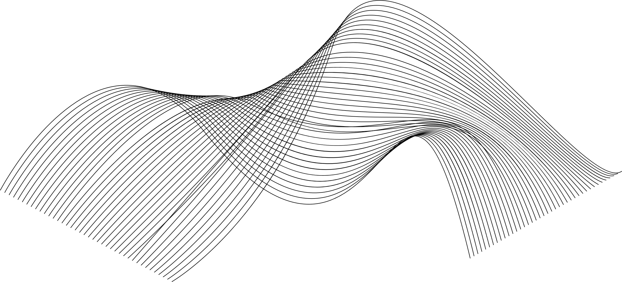
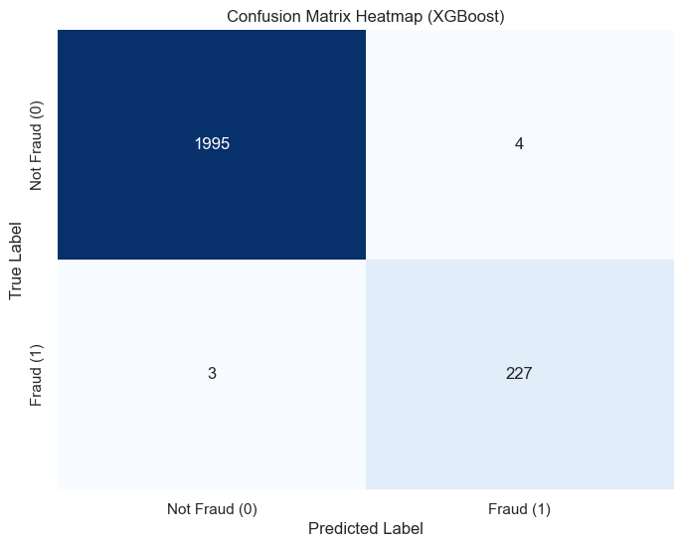

CONFUSION MATRIX--> XGBoost
True Negatives (1995):
The model correctly identified 1995 legitimate transactions as Not Fraud.
True Positives (227):
227 actual fraudulent transactions were correctly identified as fraud.
False Positives (4):
Only 4 non-fraud transactions were incorrectly flagged as fraud — very low.
False Negatives (3):
Just 3 fraud transactions were missed and predicted as non-fraud — also very low.

Slide 14
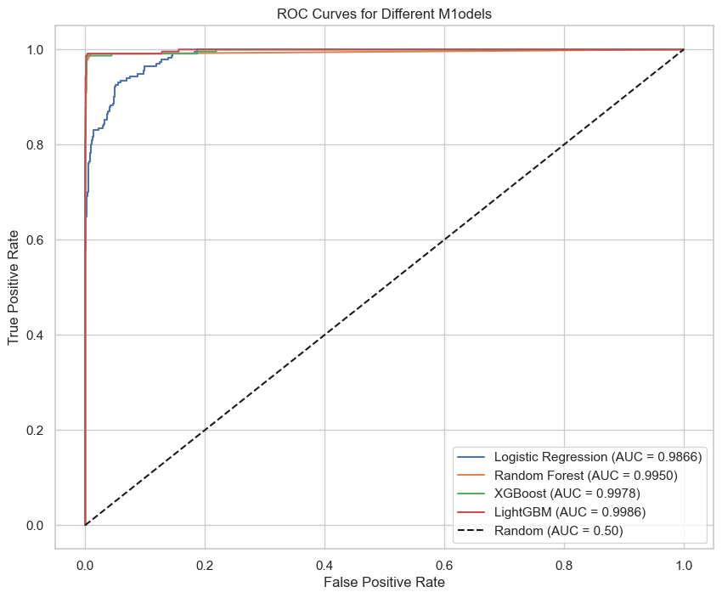
ROC AND AUC CURVES
--- ROC CURVES AND AUC SCORES --
Logistic Regression AUC: 0.9866
Random Forest AUC: 0.9950
XGBoost AUC: 0.9978
LightGBM AUC: 0.9986

Slide 15


TRANSACTION TYPE PATTERNS
KEY INSIGHTS FROM EDA
Fraudulent transactions are predominantly associated with the TRANSFER and CASH_OUT transaction types.
These types are commonly exploited for unauthorized fund movements.
RECEIVER’S BALANCE BEHAVIOR
In many fraud cases, the receiver’s balance remains unchanged after the transaction.
This suggests that the receiver account may be fictitious or inactive, Aa fraudulent transfer.
BALANCE DISCREPANCY SIGNALS
Large differences between the sender’s old and new balance, especially when not reflected on the receiver’s side, often signal fraud.
These imbalances are red flags in fraudulent transactions.
TRANSACTION AMOUNT INSIGHTS
Fraud cases are more frequently observed in medium to high-value transactions.
Low-value transactions are less likely to be fraudulent, making amount size a significant risk indicator.

Slide 16

CONCLUSION
--WHY XGBoost--
SUMMARY
This project focused on building a robust and accurate machine learning model to detect fraudulent financial transactions. After evaluating multiple algorithms—including Logistic Regression, Random Forest, LightGBM, and XGBoost—the XGBoost Classifier emerged as the best performer.
Handles Imbalanced Data Efficiently
Regularization
The selection of XGBoost led to a high-performance fraud detection system capable of:
Accurately identifying complex fraud patterns
Minimizing both customer inconvenience and financial loss
Being deployed in real-time financial environments for transaction monitoring
Speed and Scalability
Feature Importance & Interpretability
Consistent Accuracy Across Folds

Slide 17
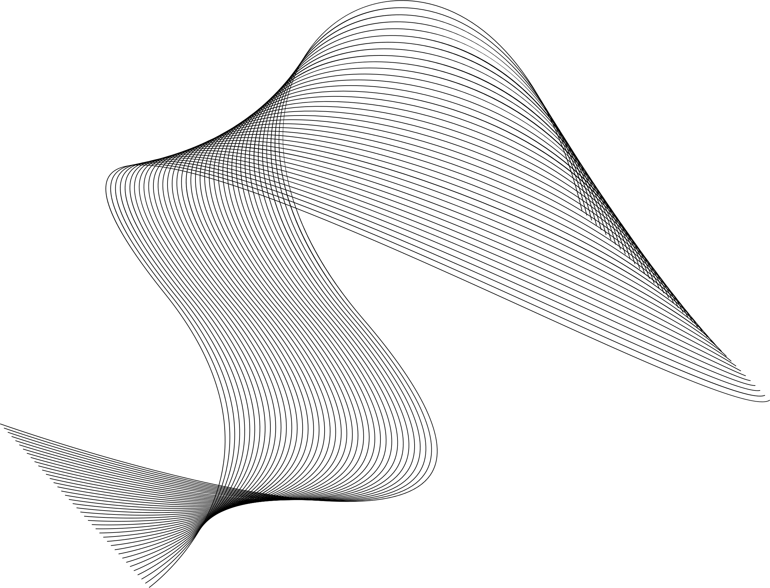




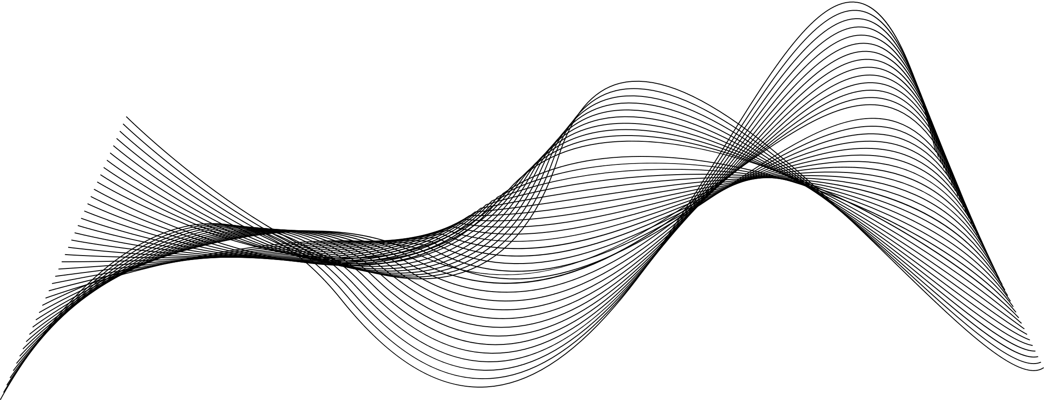
IMPLICATIONS OF THE WORK
The successful implementation of this model has real-world relevance:
01
02
03
04
Reduces Financial Loss
Increases Security
Deployable in Real-Time Systems
Supports Risk Management
By identifying fraudulent activities early, it helps reduce losses.
Enhances transaction safety and builds trust among customers.
With high precision and recall, the model is ready for production environments in banking and fintech platforms.
Can assist compliance and audit teams in better fraud surveillance.

Slide 18
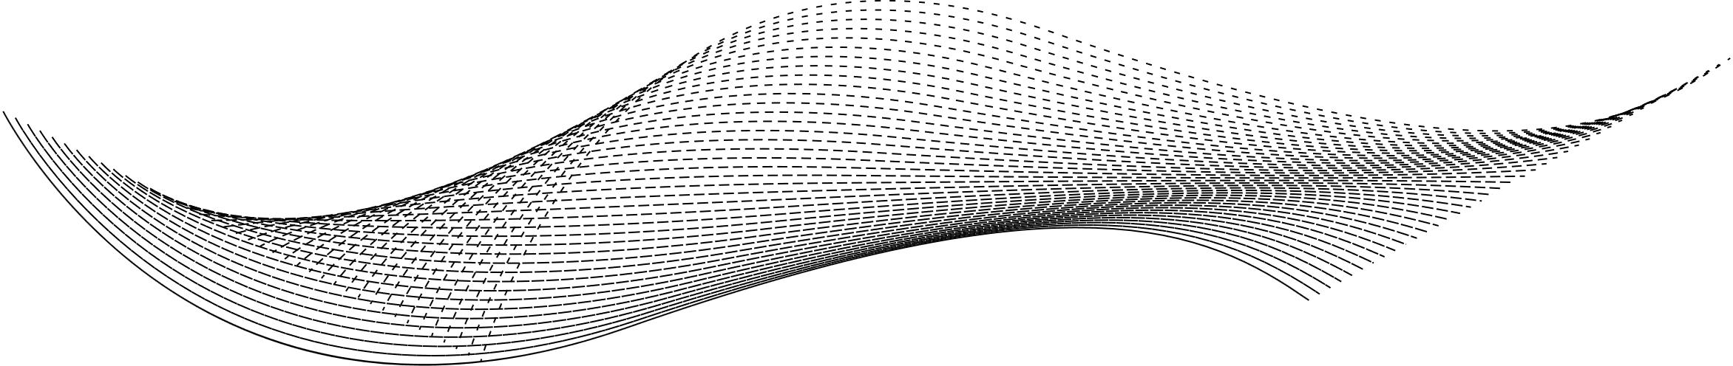


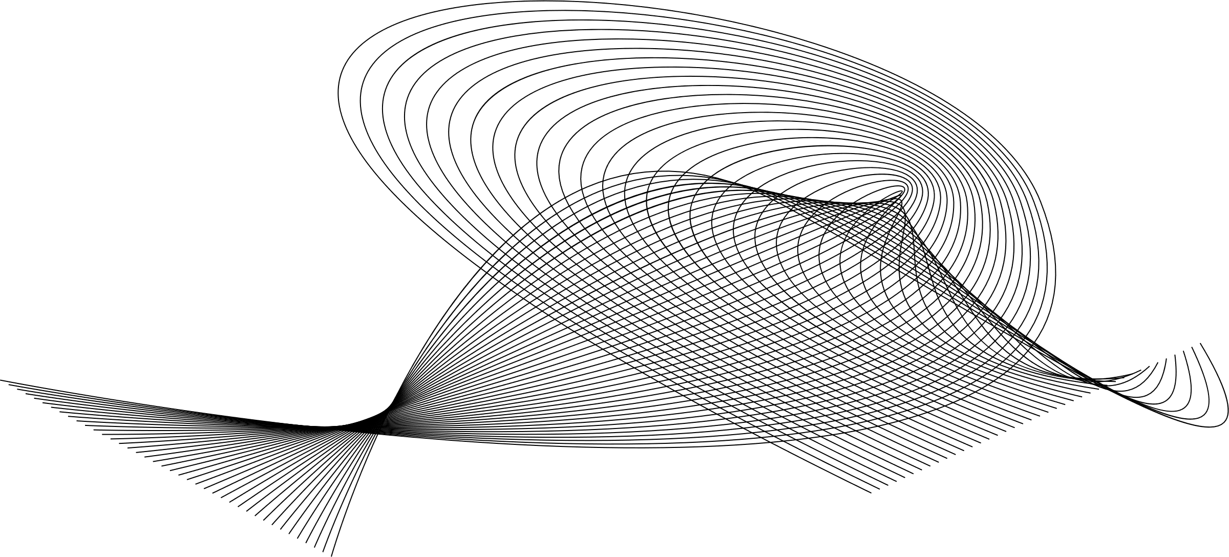
Future Work
Real-Time Deployment
Dashboard Integration
Use Flask or FastAPI to serve the model for real-time transaction scoring and alert generation.
Link model predictions with interactive dashboards (e.g., Power BI or Streamlit) for live monitoring.
Deep Learning Approaches
Adaptive Learning Pipelines
Explore RNNs, LSTMs, or Autoencoders to capture complex, time-based fraud patterns.
Develop a system that continuously learns from new data using scheduled model retraining and concept drift detection.

Slide 19













Boosting Productivity in Fraud Detection
Continuous Monitoring & Evaluation:
Regularly monitor performance metrics and use drift detection algorithms to maintain model accuracy over time.
Model Optimization
Apply techniques like hyperparameter tuning, model pruning, quantization, or ONNX export to reduce latency and computational cost.
Team Collaboration Tools
Use GitHub, Jira, Trello, or Slack for better collaboration, version control, and task management.
Automated Data Pipelines
Use tools like Apache Airflow, MLflow, or Prefect to automate preprocessing, model training, and deployment workflows.
Real-Time Alerting System
Integrate fraud prediction APIs with notification systems (Slack, Email, SMS) for immediate fraud alerts

Slide 20

Questions ?
CONFIDENTIAL: The information in this document belongs to Boston Institute of Analytics LLC. Any unauthorized sharing of this material is prohibited and subject to legal action under breach of IP and confidentiality clauses.

Slide 21
Thank You!
CONFIDENTIAL: The information in this document belongs to Boston Institute of Analytics LLC. Any unauthorized sharing of this material is prohibited and subject to legal action under breach of IP and confidentiality clauses.

